Slide 1
Stage
ADC Sigma Delta modelling

Slide 2
Presentation
ADC / DAC
Objectifs
Planning

Slide 3
PRESENTATION
Telecom satellites are moving from full analogue to full digital
It implies use of more and more powerfull Anologue to Digital Converters (ADC) and Digital to Analogue Converters (DAC)
More bandwidth
Higher frequency band
More dynamic
The purpose of this training period is to work on wideband ADC and DAC modelling on an Active antenna.
The idea is to dig sigma delta architectures which are used on some systems to be able to get direct access to Ka band

Slide 4
ADC
A/D CONVERTER
Clock (rate R)
Classical
Input:
Continuous analogue
waveform
Output:
Sequence of digital
samples
0
1
0
0
1
1
1
1
0
0
0
1
0
1
1
1
1
1
0
0
0
0
1
1
1
1
0
0
1
0
0
1
0
1
0
0
0
1
1
0
1
0
0
0
0
1
1
1
1
1
1
0
1
1
0
1
0
0
1
0
0
0
1
1
1
1
1
1
0
0
1
0
1
0
1
0
0
1
0
1
0
1
1
0
0
1
1
0
0
1
0
1
0
0
1
0
0
0
1
0
0
0
time
Sample
B bits
A/D Converter
Dynamic range of 6dB/bit
Key performance parameters:
Sample rate (R sam/s)
Sample word length (B bits)
2^{B} quantised levels
freq
freq
Quantisation noise
Wanted
signal
Residual unwanted
signal
R/2
Unwanted signal
aliases into wanted
signal band
R/2

Slide 5
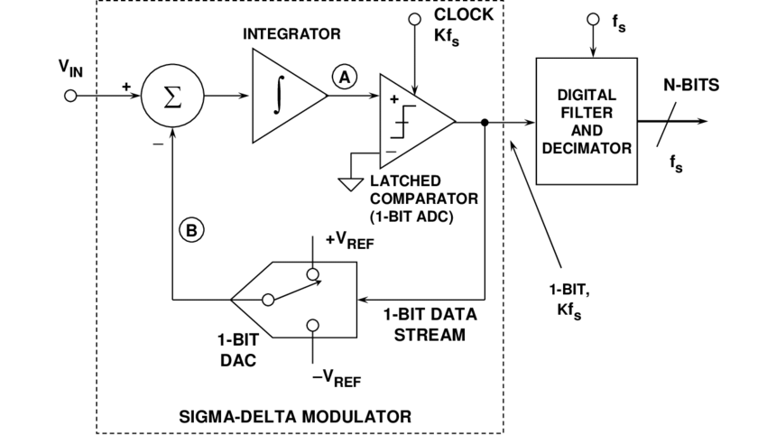
ADC SIGMA DELTA
Design overview : Use of a 1 bit DAC and 1 bit ADC, then filter and decimate to recover dynamic

Slide 6
DAC
D/A Converter
Clock (rate R)
Classical
Input:
Sequence of digital
samples
Output:
Continuous analogue
waveform
D/A Converter
Sample
B bits
1
1
0
0
1
0
0
1
0
1
0
0
0
1
1
0
1
0
0
0
0
1
1
1
1
1
1
0
1
1
0
1
0
0
1
0
0
0
1
1
1
1
1
1
0
0
1
0
1
0
1
0
0
1
0
1
0
1
1
0
0
1
1
0
0
1
0
1
0
0
1
0
0
0
1
0
0
0
time
Key performance parameters:
Sample rate (R sam/s)
Sample word length (B bits)
freq
Wanted
signal
Unwanted image
R/2

Slide 7
OBJECTIVES
OBJECTIVES
State of Art study
ADC / DAC Sigma Delta : Look at the Analogue devices pages:
  https://www.analog.com/en/resources/interactive-design-tools/sigma-delta-adc-tutorial.html
Look at articles and thesis
Prepare a report
Python Coding
Model single ADC
Test various waveforms to see impact on SNR
  Learn how to tune to get more bandwidth / dynamic
Model single DAC
Model 512 ADC in parrallel (active antenna)
  True time delay beam former
  Adding active antenna geometry
  Form beams
Test signals on active antenna

